Slide 1

Topic Modeling using NLP
James Njoroge maina

Slide 2
Introduction.
Goal:
The main goal of this project is to analyze tweets for a company and come up with topics from the text.
Why:
An understanding of what your customers are saying about you helps a lot in coming up with policies that increase customer retention and in turn increasing revenue.

Slide 3
Steps.
Information gathering.
Data cleaning.
Exploratory Data Analysis (EDA) .
Feature engineering
Model creation.

Slide 4
1. Information gathering
There were 2 main tweet gathering methods that were considered:
Using the twitter provided API. I chose to discard this option due to the lengthy and complicated steps required to get access to it and it also had a cost implication.
Scrapping through twitter using a tool. This was relatively straight forward and there are numerous open source packages and software to do this.
I used Octoparse 8, a data scrapping software to collect tweets for Kenya power and lighting company (KPLC) for the days between 1st of Jan 2021 to 31st Dec 2021.
I was able to collect a total of 2783 tweets.

Slide 5
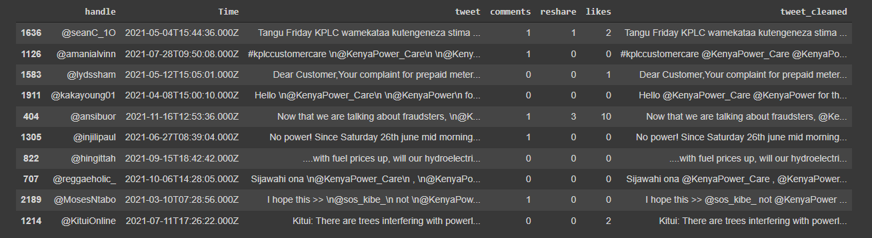
Data cleaning.
The above snapshot shows a random selection of the data collected.
The data was relatively clean. I only removed the next line tags that appeared very frequently in the tweets, special character and converted contractions to their original form using the contractions library.

Slide 6
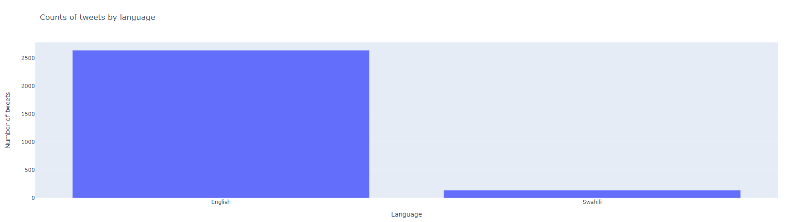
EDA.
I explored the data by going through some of the records manually and drawing graphs to visualize the data.
The first thing I noticed is that the tweets were written in 2 languages, Kiswahili and English which is expected. I used a language classification model to tag each tweet and here is a graph showing the distribution of the 2 languages. English tweets: 2641 and Swahili tweets: 142

Slide 7
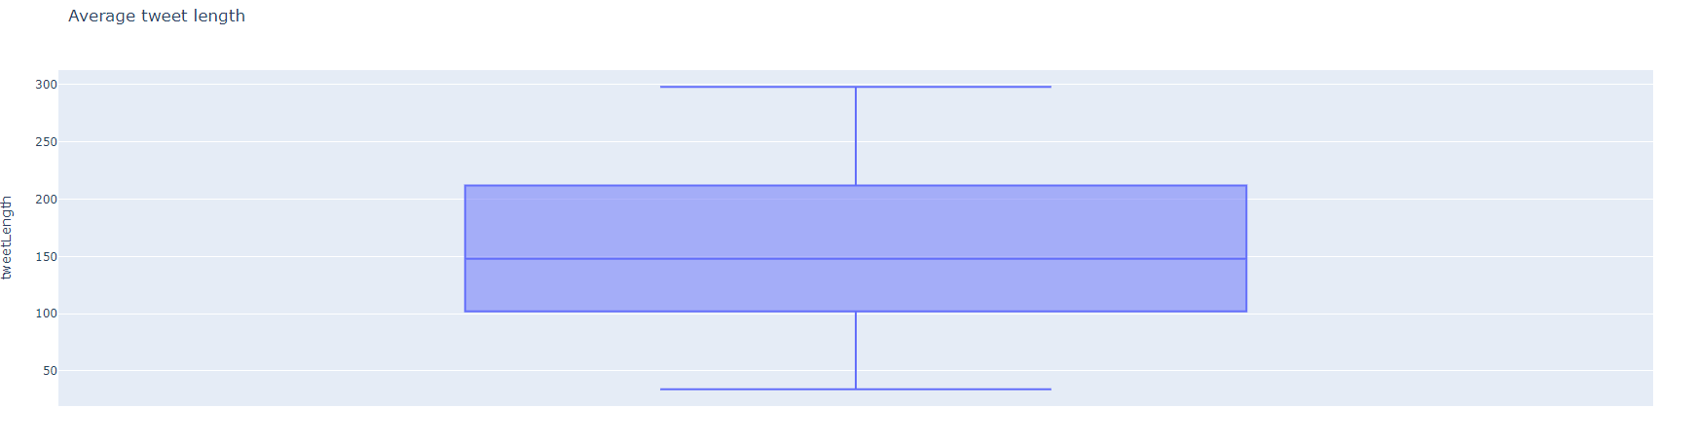
There are a number of methods already defined for topic modeling but in order to select the right one you need to understand the distribution of length of the text you are working with. A simple box plot provides a great representation of the distribution.
Upper bound length – 298 characters. Lower bound length – 34 characters. median length – 148 characters

Slide 8
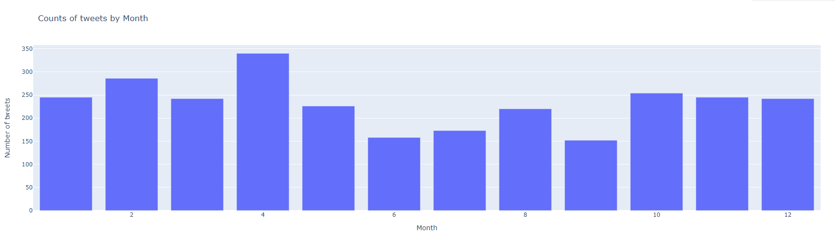
As a bonus, I decided to analyzed the timestamps collected with the tweets to understand user behaviors and patterns.
From the analysis I found out that most users tweet during the 1st half of the year with a reduced number of tweets for the following months and slight increase in the last quarter of the year.
Most users tweet between 3pm and 6pm.

Slide 9
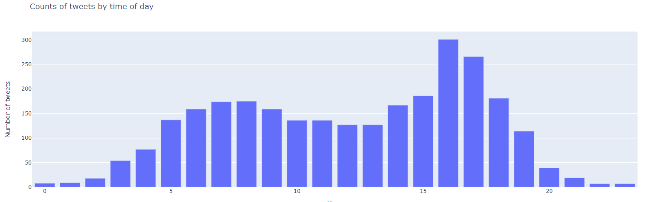

Slide 10
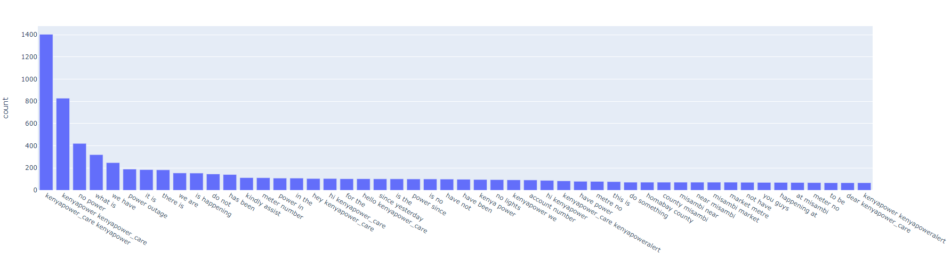
Finally I did a word count to get a list of the most recurring words which was very useful in the feature selection stage.
From this, I realized that some words were irrelevant and appeared multiple times thus would skew my results.

Slide 11
Feature engineering.
This is a crucial stage since the quality of your input determines the quality if your output.
For NLP, we only have one input which is the text being analyzed but we need to clean up the data and convert the output to a mathematical representation.
Removing stop words.
Stop words are words in sentences that give no extra meaning to the statement, they are useful for humans but only confuses machines. We need to exclude stop words for better performance and results. Most Language processing libraries provide a list of stop words, so I used the stop words provide by NLTK and added to the list using my own that I had discovered during EDA.

Slide 12
Standardize similar words.
Most languages have similar words being expressed differently due to conditions like tenses. E.g. come, can also be came. The underlying meaning of the words doesn’t really change, the variation only adds to the meaning.
In NLP we try to group this kind of words together because we treat this words as synonymous. There are 2 major ways of doing this:
Stemming - which involves getting the simplest form of the word without following any grammar e.g. for finally and final, their stem would be fina
Lemmatization – involves getting the base form of the words, this follows grammar. E.g. for finally and final, their lemma would be final.
In our we project we chose lemmatization since we wanted to retain meaning of the words and we don’t have a huge data set s we won’t be using the computational advantage provided by stemming.
We used the NLTK stemmer which needs you to also compute the Part of speech tags for the sentence for better stem prediction in accordance to the reference the word is being used in.
I also manually converted uncommon contraction to their proper form since they were being treated differently e.g. meter no to meter number.

Slide 13
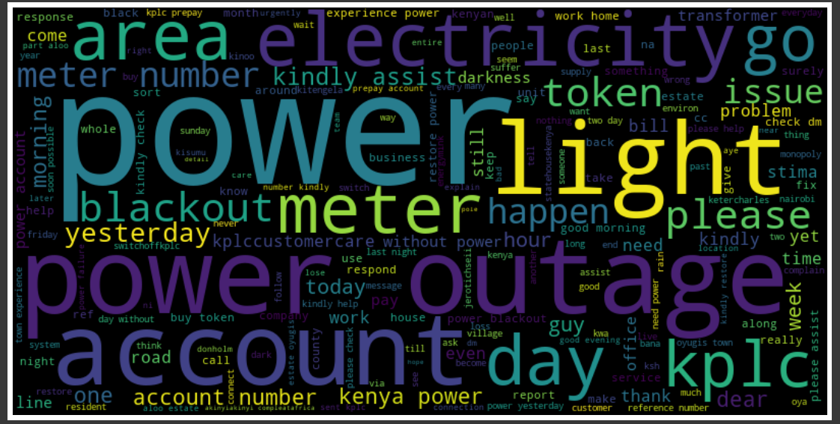
Here is a word cloud displaying the most occurring words in our data set.

Slide 14
Converting text to a mathematical representation.
We now need to convert the text data to an appropriate input format. Ideally we are count vectorizing the words (count how may times a word appears in the whole data set and using that as a representation for the word).
There are many ways to achieve this but I considered 2 main ways:
Bag of words
TF-IDF
We went with TF-IDF due to it’s ability to rank words with the most relevance to a dataset.
We utilized the TfidfVectorizer module provided by sklearn.

Slide 15
Model creation.
We are now ready to perform some machine learning.
There are 2 main techniques we could explore:
LSA (Latent semantic analysis) – involves analyzing relationships between sentences and the key words they contain by producing a set of concepts related to the sentences and key words. In this approach each sentence in linked to only one concept.
LDA (Latent Dirichlet allocation) – This is a statistical model that allow a set of observation to be explained by unobserved groups. In this approach a sentence can contain multiple unobserved groups.
We are going to try out both of these approaches to see which provides the best results.
LSA
I explored this methods using 2 technques.
Using the provided TruncatedSVD model by sklearn.
Using Kmeans model provide by sklearn.

Slide 16
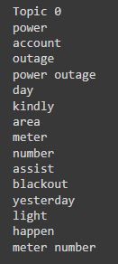
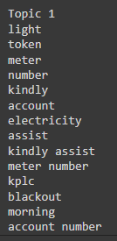
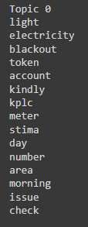
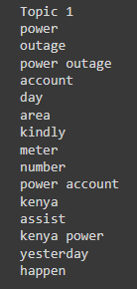
Here are the concepts derived from each method.
TruncatedSVD
Kmeans

Slide 17
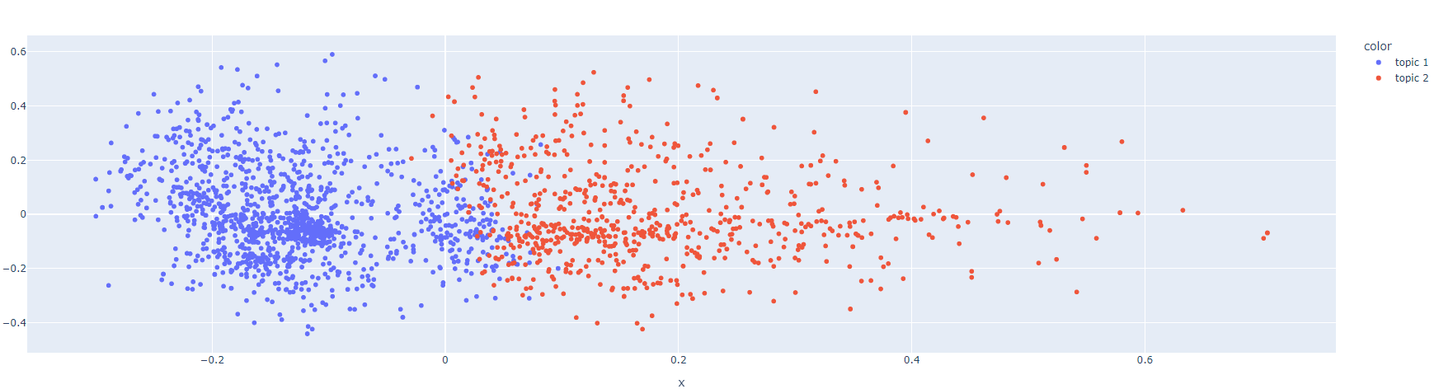
Presentation of tweets color coded in reference to topic.

Slide 18
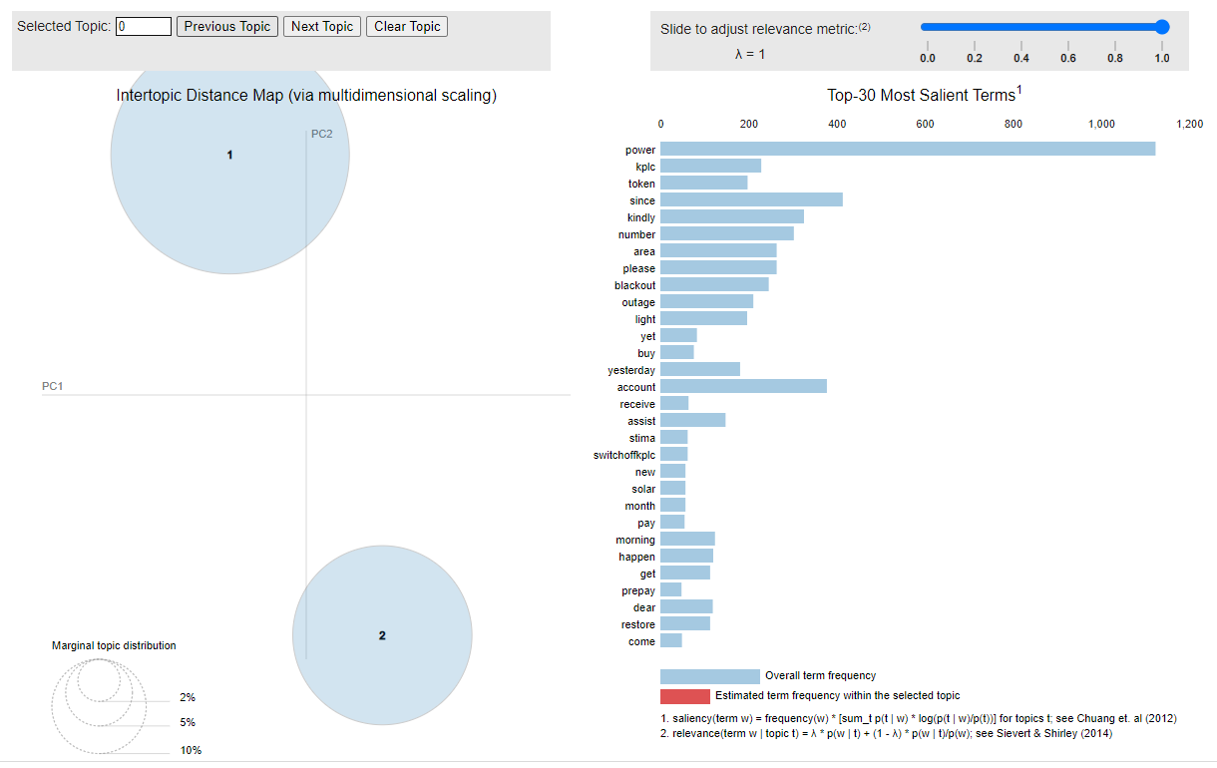
LDA
For this approach we used models provided by genism which provided a very neat chart on the relationships between different topics.

Slide 19
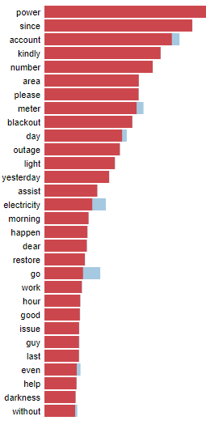
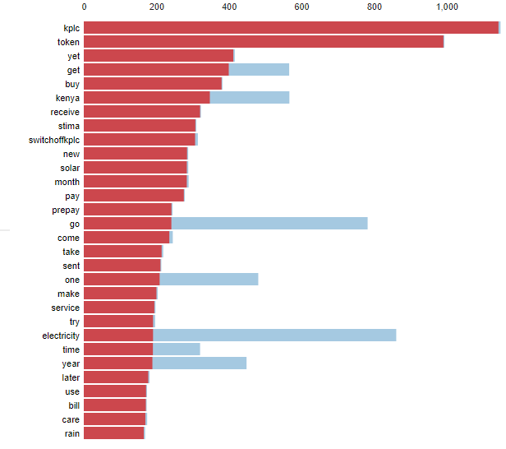
Topic 0
Topic 1

Slide 20
In all the 3 approaches I had play around with the model parameter in order to land the results we got.
Conclusion
I got an optimum of 2 topics from the data set I had collected.
From the key words, 2 main topics stood out:
Power outage.
Token Enquires.

